Slide 1
FOREM - Presentation
High-level Conference, October 23, Barcelona European Year of Skills and Active Labour Market Policies

Slide 2
digital upskilling and lifelong digital learning
Forem wants to become more and more “phygital” to face the challenges of our modern world. Society and labour market become digital and this means we all have to adapt and be flexible.
In this short presentation, Forem will explain good practices related to its publics : the “smart jobs/corners”, “digitial factories” and “digital learning platforms”.
More, Forem will present how it worked on the digital gap within its own staff.

Slide 3
Focus on “SMART JOBs” and “SMART CORNERS”
What are « Smart jobs »?
Four-hour workshops: training adapted to their needs, discovery and use of digital tools, testing of skills, and more
What are « Smart corners »?
A digital area to train jobseekers to become digitally autonomous
Multimedia area: activities to use digital tools (virtual reality, job interview simulation, creation of a video CV, etc.)
What are the goals?
Raising awareness among jobseekers to show them the importance of digitalisation, especially in the frame of their job search
Having a better insight of their level of knowledge regarding digital skills
Being able to use the online services Forem provides
Tackling digital fracture in Wallonia

Slide 4
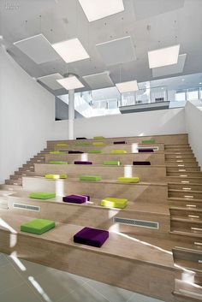
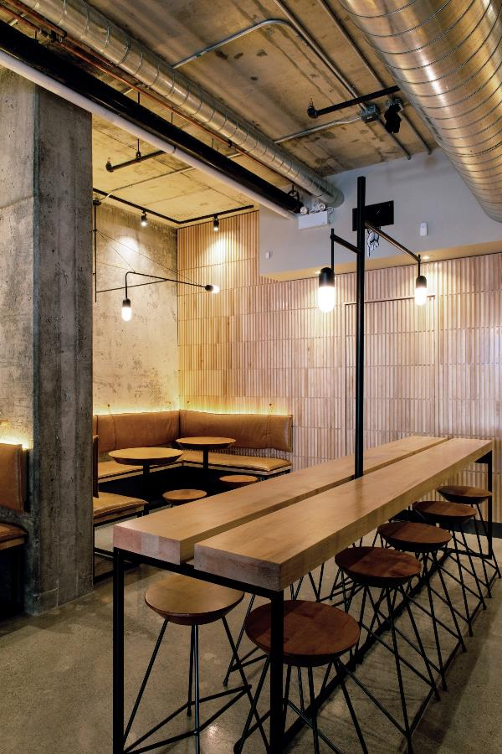
Focus on the “DIGITAL FACTORies” Open space where people can gather to work, acquire knowledge and/or skills, meet or simply exchange informally
Adapted
design
Goal
Practical training for basic digital skills (24 to 40 hours) or technological skills in a
multidisciplinary approach
Immersion into a professional context (rooms with prototyping tools, like 3D printers)
Certification (individual or collective certification for basic digital skills or
technological skills)
Target groups
Jobseekers, trainees, young people,… → all citizens
Principles
Mixed target groups and activities
Openness (target groups, partnerships, flexibility)
Process continuously evolving
Participants networking
NWOL (New ways of learning → learning through experience)
Formal and informal areas
9 sites in Wallonia: 5 to be built and 4 to be upgraded

Slide 5
Focus on “Digital learning” Physical and virtual platforms
Target groups
Training professionals (trainers from Forem, from skills centres, etc.) + partnerships in Wallonia
Learners
Companies
Resources
1 physical platform: in Liège (will be implemented by 2024)
Virtual platforms (Moodle, for example)
Goals:
Developping products, pedagogical content and methods (Promoting digital learning and making it accessible to everyone; Offering a reliable technical infrastructure)
Sharing equipment and tools, content and resources, but also approaches, knowledge and skills
Exploring pedagogical pratices and technologies, alone or in groups
Offering more and more digital training by combining methods (remotely, blended learning, etc.)

Slide 6
FOCUS ON Forem staff members’ DigitalisatioN by « Forem Academy » and management Committee
Skills assessments questionnaires with analysis of individual results
(no obligation to discuss them with their hierarchy)
Training calalogues
(adapted to the various digital skills)
On-line registration for training adapted to the needs identified
(remote training, but also on site)

